Slide 1







Adima Technologies Private Limited
-Built with Purpose

Slide 2

Who We Are:
‘Adima’ Is A Product – Based Company, Building “5”
Next-Gen Products In INDIA
Registered as a Private Limited Company, CIN: U62099TS2024PTC187401

Slide 3
Where We Operate:
We are incubated at T-Hub, the world’s largest startup incubation ecosystem, providing us with access to:
Mentorship from global industry experts
Investor Network & Funding Opportunities
Corporate & Enterprise Network Access
Access to cutting-edge technology resources and labs
Workshops, events, and startup community support
Location: T-Hub, 4Th Floor, Raiduram, Knowledge City Road, Hyderabad

Slide 4
What we are building:
“Adima Technologies” builds and scales consumer platforms across Social Media, Classifieds, Matrimony, E-Commerce, and EV Mobility through products like:
1. EkPage
2. 2true
3. Upto6
4. 11thOne.
5. Bejdo
For More, Visit: www.adimatechnologies.com

Slide 5
EkPage:
India’s first multi-feature social media platform
Designed for seamless social experiences in one app
State & language filters, curated categories for easy discovery
Verified profiles and content to ensure trust and quality
Beta version live on the Google Play Store and Apple App Store
Key Features: Community Groups • Creators • News • Memes • G-Post • Deals
USP: 6 Features | 6 Feeds | 1 Application
For More, Visit: www.ekpage.com

Slide 6
2true:
India’s first matrimony app with ‘physically verified profiles’
Built to eliminate fake profiles and ensure genuine, secure connections
Verification Includes Height, Weight, Photos, Education, Salary/Business Etc
Advanced privacy and security features to protect user data
Smart matching AI algorithms to help users find compatible partners
Key Features: Physically Verified, Verified Badges, Privacy-Focused Request-Based Connections • Unlimited Communications
USP: 100% Physically Verified Profiles
For more, visit: www.2true.in

Slide 7
Upto6:
Dedicated e-commerce platform for kids aged 0–6
Curated essentials across clothes, toys, skincare, feeding, bath, and more.
No-confusion shopping through an exclusive, clutter-free app
Parent-friendly design with simple discovery and smooth checkout
Safe, age-appropriate, and quality-focused product selection
USP: A focused ecosystem for a child’s most important early years
For more, Visit: www.upto6.com

Slide 8
Bejdo:
Trusted local marketplace for verified buyers and sellers
User-friendly interface for easy listing and discovery
Location-based search to find nearby deals quickly
Text-only in-app chat with community reporting to ensure safety
Multi-category advertising for individuals and small businesses
Community reporting system to flag fake profiles
USP: Safe, Local & Hassle-Free Classifieds
For more, Visit: www.bejdo.in

Slide 9

11thOne:
“EV mobility platform” offering
Naked-Adventure bikes and lightweight scooters for women.
Safe, stylish, and efficient urban and off-road mobility
Designed for adventure seekers and everyday riders
Prototype under development
USP: Stylish, Adventure and convenience combined
For more, Visit: www.11thone.com

Slide 10
What Makes Adima Different:
Addressing Real Market Gaps: Solving fake profiles, confusing kids’ shopping, limited EV options, and fragmented social media
Multi-Product, Multi-Industry Platforms: Social Media, Matrimony,
E-Commerce, Classifieds & EV Mobility
First-of-Its-Kind Innovations in each sector
Verified, Safe & Trustworthy experiences for all users
Consumer-Focused & Easy-to-Use platforms
Scalable Products with a unified technology vision

Slide 11
Why Adima Stands Out:
Advanced Technology: Cutting-edge solutions
Stylish & Thoughtful Design: Modern, user-friendly, appealing
Eco-Friendly & Sustainable: Environmentally conscious
Premium Quality: High value, no cheap tag
Easy to Use: Intuitive and hassle-free
Trustworthy & Reliable: Verified, safe, consistent
Economical Post-Look: Affordable without compromising style

Slide 12
What We Are Looking For:
Passion & Drive: Motivated, proactive, eager to make an impact
Innovation Mindset: Creative thinkers with fresh ideas
Ownership & Accountability: Take responsibility and deliver results
Team Players: Collaborative, communicative, willing to learn
Adaptability: Comfortable with change and fast-paced environments
Customer-Centric: Focused on creating value and great user experiences

Slide 13
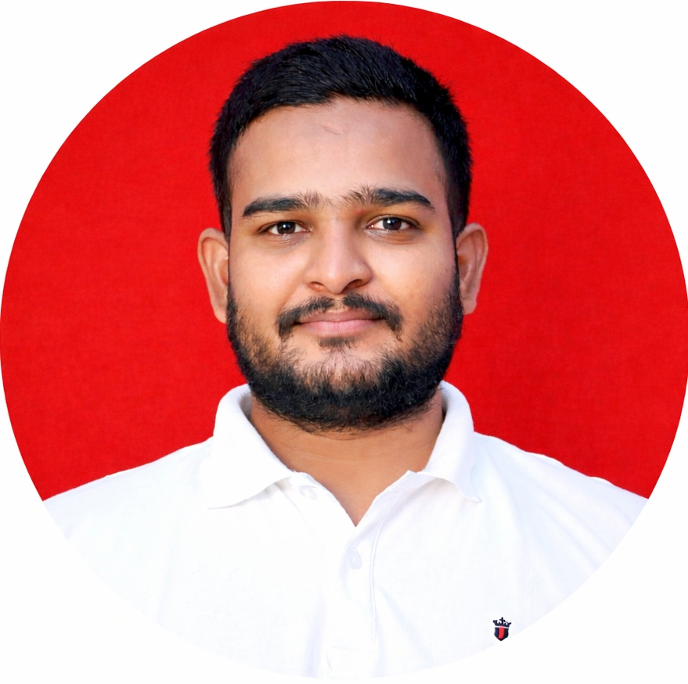
About The Founder:
Mr.Peddinti Ashok M.B.A Chairman & Managing Director – Adima Technologies Pvt. Ltd. Founder & CEO of EkPage, 2True, Upto6, Bejdo and 11thOne

Slide 14
Contact:
Get in Touch:
Company Name: Adima Technologies Pvt Ltd
Add: T-Hub, 4th Floor, Hyderabad – 500032
HR Name: M. Srikanya
Email: hr@adimatechnologies.com
Phone: +91 95022 47807
Website: www.adimatechnologies.com

Slide 15
Any Questions:
We’re happy to answer!

Slide 16

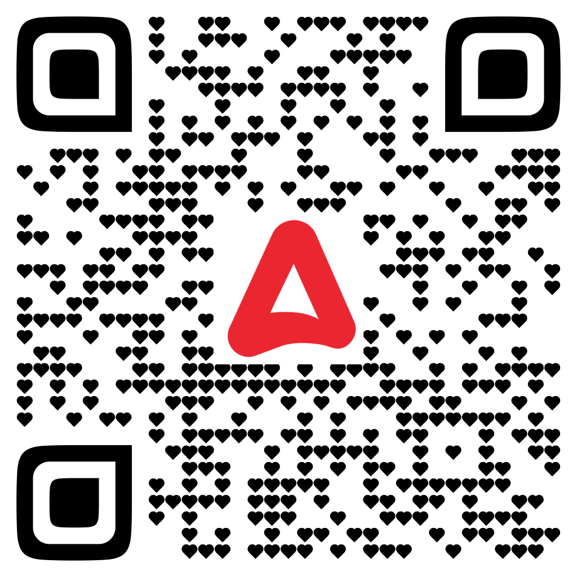
Thank you:
Follow Us:
LinkedIn | Instagram

